Slide 1
Speech Recognition
Segment-Based Speech Recognition

Slide 2
Outline
Introduction to Segment-Based Speech Recognition
Searching graph-based observation spaces
  Anti-phone modeling
  Near-miss modeling
Modeling landmarks
Phonological modeling

Slide 3
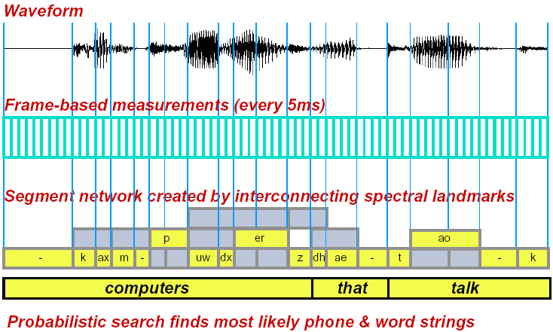
Segment-Based Speech Recognition

Slide 4
Segment-Based Speech Recognition
Acoustic modeling is performed over an entire segment
Segments typically correspond to phonetic-like units
Potential advantages:
  Improved joint modeling of time/spectral structure
  Segment- or landmark-based acoustic measurements
Potential disadvantages:
  Significant increase in model and search computation
  Difficulty in robustly training model parameters

Slide 5
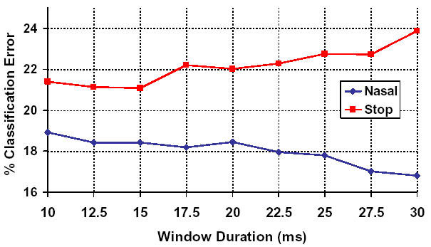
Hierarchical Acoustic-Phonetic Modeling
Homogeneous measurements can compromise performance
  Nasal consonants are classified better with a longer analysis window
  Stop consonants are classified better with a shorter analysis window
Class-specific information extraction can reduce error.

Slide 6
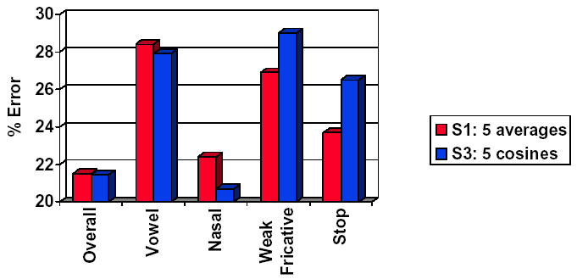
Committee-based Phonetic Classification
Change of temporal basis affects within-class error
  Smoothly varying cosine basis better for vowels and nasals
  Piecewise-constant basis better for fricatives and stops
Combining information sources can reduce error.

Slide 7
Phonetic Classification Experiments (A. Halberstadt, 1998)
TIMIT acoustic-phonetic corpus
  Context-independent classification only
  462 speaker training corpus, 24 speaker core test set
  Standard evaluation methodology, 39 common phonetic classes
Several different acoustic representations incorporated
  Various time-frequency resolutions (Hamming window 10-30 ms)
  Different spectral representations (MFCCs, PLPCCs, etc)
  Cosine transform vs. piecewise constant basis functions
Evaluated MAP hierarchy and committee-based methods

Slide 8
Phonetic Classification Experiments (A. Halberstadt, 1998)
Evaluation Results
Method | %Error
Baseline | 21.6
MAP Hierarchy | 21.0
Committee of Classifiers | 18.5
Committee with Hierarchy | 18.3

Slide 9
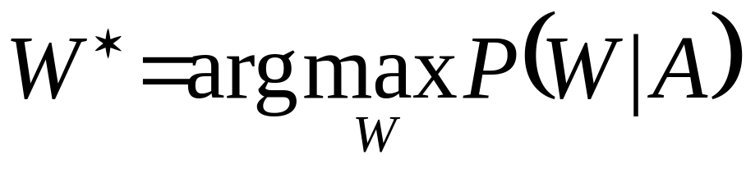
Statistical Approach to ASR
P(W)
Given acoustic observations, A, choose word sequence, W*, which maximizes a posteriori probability, P(W|A)
Language
Model
W
Linguistic
Decoder
Words W’
Signal
Processor
A
Acoustic
Model
Speech
P(A|W)

Slide 10
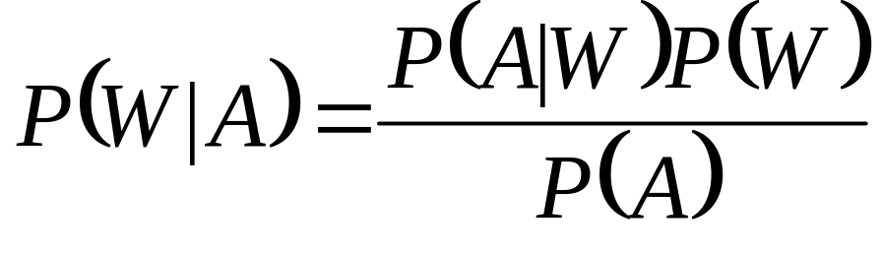
Statistical Approach to ASR
Bayes rule is typically used to decompose P(W|A) into acoustic and linguistic terms

Slide 11
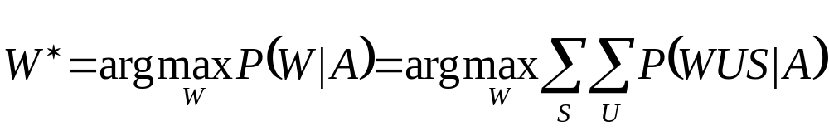

ASR Search Considerations
A full search considers all possible segmentations, S, and units, U, for each hypothesized word sequence, W
Can seek best path to simplify search using dynamic programming (e.g., Viterbi) or graph-searches (e.g. A*)

Slide 12

ASR Search Considerations
The modified Bayes decomposition has four terms:
In HMM’s:
  P(A|SUW) corresponds to acoustic model likelihood
  P(S|UW)P(U|W) corresponds to state model likelihood
  P(W) corresponds to language model probability.

Slide 13
Examples of Segment-based Approaches
HMMs
  Variable frame-rate (Ponting et al., 1991, Alwan et al., 2000)
  Segment-based HMM (Marcus, 1993)
  Segmental HMM (Rusell et al., 1993)
Trajectory Modeling
  Stochastic segment models (Ostendorf et al., 1989)
  Parametric trajectory models (Ng. 1993)
  Statistical trajectory models (Goldenthal, 1994)
Feature-based
  FEATURE (Cole et al., 1983)
  SUMMIT (Zue et al. 1989)
  LAFF (Stevens et al., 1992)

Slide 14
Segment-based Modeling at MIT
Baseline segment-based modeling incorporates:
  Averages and derivatives of spectral coefficients (e.g., MFCCs)
  Dimensionality normalization via principal component analysis
  PDF estimation via Gaussian mixtures
Example acoustic-phonetic modeling investigations, e.g.,
  Alternative probabilistic classifiers (e.g., Leung, Meng)
  Automatically learned feature measurements (e.g., Phillips, Muzumdar)
  Statistical trajectory models (Goldenthal)
  Hierarchical probabilistic features (e.g., Chun, Halberstadt)
  Near-miss modeling (Chang)
  Probabilistic segmentation (Chang, Lee)
  Committee-based classifiers (Halberstadt)

Slide 15
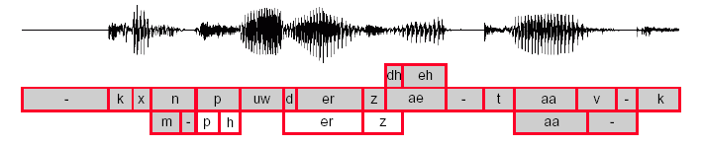
SUMMIT Segment-Based ASR
SUMMIT speech recognition is based on phonetic segments
  Explicit phone start and end times are hypothesized during search
  Differs from conventional frame-based methods (e.g., HMMs)
  Enables segment-based acoustic-phonetic modeling
  Measurements can be extracted over landmarks and segments

Slide 16
SUMMIT Segment-Based ASR
Recognition is achieved by searching a phonetic graph
  Graph can be computed via acoustic criterion or probabilistic models
  Competing segmentations make use of different observation spaces
  Probabilistic decoding must account for graph-based observation space

Slide 17
“Frame-based” Speech Recognition
Observation space, A, corresponds to a temporal sequence of acoustic frames (e.g., spectral slices)
Each hypothesized segment, s_{i}, is represented by the series of frames computed between segment start and end times
A = {a₁a₂a₃}
a₁
a₂
a₃
a₁ a₂
a₂ a₃

Slide 18
“Frame-based” Speech Recognition
The acoustic likelihood, P(A|SW), is derived from the same observation space for all word hypotheses
P(a₁a₂a₃|SW) ⬄ P(a₁a₂a₃ |SW) ⬄ P(a₁a₂a₃|SW)

Slide 19
“Feature-based” Speech Recognition
Each segment, s_{i}, is represented by a single feature vector, a_{i}
Given a particular segmentation, S, A consists of X, the feature vectors associated with S, as well as Y, the feature vectors associated with segments not in S: A = X∪Y
A = {a₁a₂a₃a₄a₅}
a₁
a₃
a₅
a₂
a₄
X={a₁a₃a₅}
Y={a₂a₄}
X={a₁a₂a₄a₅}
Y={a₃}

Slide 20
“Feature-based” Speech Recognition
To compare different segmentations it is necessary to predict the likelihood of both X and Y: P(A|SW) = P(XY|SW)
P(a₁a₃a₅a₂a₄ |SW) ⬄ P(a₁a₂a₄a₅a₃ |SW)

Slide 21

Searching Graph-Based Observation Spaces: The Anti-Phone Model
Create a unit, α’, to model segments that are not phones
For a segmentation, S, assign anti-phone to extra segments
  All segments are accounted for in the phonetic graph
  Alternative paths through the graph can be legitimately compared

Slide 22
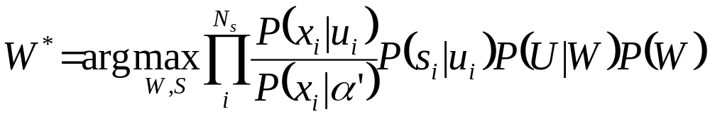
Searching Graph-Based Observation Spaces: The Anti-Phone Model
Path likelihoods can be decomposed into two terms:
  The likelihood of all segments produced by the anti-phone (a constant)
  The ratio of phone to anti-phone likelihoods for all path segments
MAP formulation for most likely word sequence, W, given by:

Slide 23
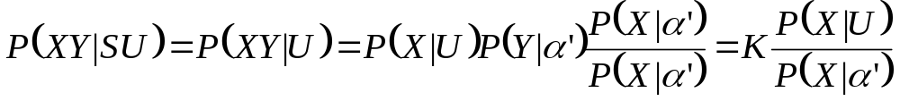
Modeling Non-lexical Units:
The Anti-phone
Given a particular segmentation, S, A consists of X, the segments associated with S, as well as Y, the segments not associated with S:P(A|SU)=P(XY|SU)
Given segmentation S, assign feature vectors in X to valid units, and all others in Y to the anti-phone
Since P(XY|α’) is a constant, K, we can write P(XY|SU) assuming independence between X and Y

Slide 24
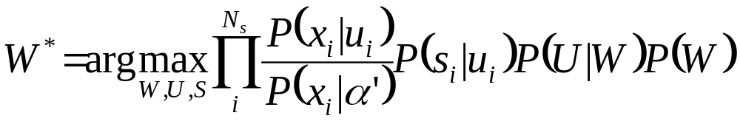
Modeling Non-lexical Units:
The Anti-phone
We need consider only segments in S during search:

Slide 25
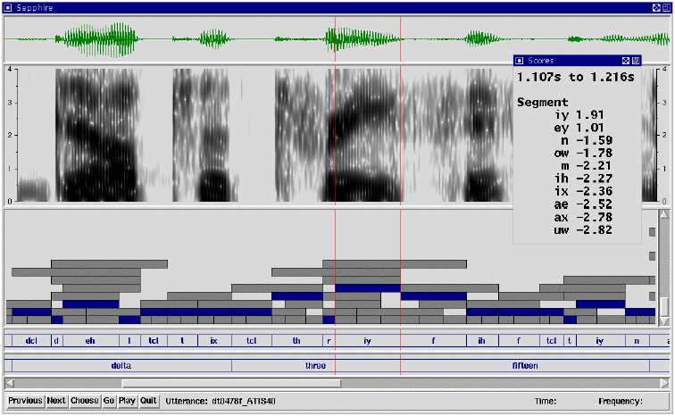
SUMMIT
Segment-based ASR

Slide 26
Anti-Phone Framework Properties
Models entire observation space, using both positive and negative examples
Log likelihood scores are normalized by the anti-phone
  Good scores are positive, bad scores are negative
  Poor segments all have negative scores
  Useful for pruning and/or rejection
  Anti-phone is not used for lexical access
No prior or posterior probabilities used during search
  Allows computation on demand and/or fast-match
  Subsets of data can be used for training
Context-independent or -dependent models can be used
Useful for general pattern matching problems with graph-based observation spaces

Slide 27

Beyond Anti-Phones:
Near-Miss Modeling
Anti-phone modeling partitions the observation space into two parts (i.e., on or not on a hypothesized segmentation)
Near-miss modeling partitions the observation space into a set of mutually exclusive, collectively exhaustive subsets
  One near-miss subset pre-computed for each segment in a graph
  Temporal criterion can guarantee proper near-miss subset generation (e.g., segment A is a near-miss of B iff A’s mid-point is spanned by B)
During recognition, observations in a near-miss subset are mapped to the near-miss model of the hypothesized phone
Near-miss models can be just an anti-phone, but can potentially be more sophisticated (e.g., phone dependent)

Slide 28
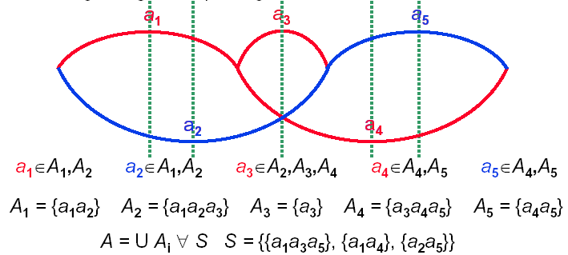
Creating Near-miss Subsets
Near-miss subsets, A_{i}, associated with any segmentation, S, must be mutually exclusive, and exhaustive: A = U A_{i} ∀A_{i}∈S
Temporal criterion guarantees proper near-miss subsets
  Abutting segments in S account for all times exactly once
  Finding all segments spanning a time creates near-miss subsets

Slide 29
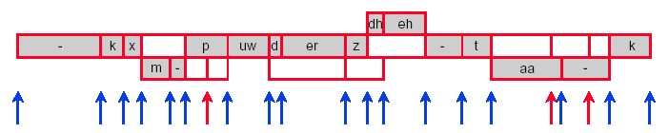
Modeling Landmarks
We can also incorporate additional feature vectors computed at hypothesized landmarks or phone boundaries
Every segmentation accounts for every landmark
– Some landmarks will be transitions between lexical-units
– Other landmarks will be considered internal to a unit
Both context-independent or dependent units are possible
Effectively model transitions between phones (i.e., diphones)
Frame-based models can be used to generate segment graph

Slide 30
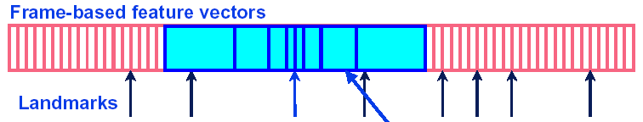
Modeling Landmarks
Frame-based measurements:
  Computed every 5 milliseconds
  Feature vector of 14 Mel-Scale Cepstral Coefficients (MFCCs)
Landmark-based measurements:
  Compute average of MFCCs over 8 regions around landmark
  8 regions X 14 MFCC averages = 112 dimension vector
  112 dims. reduced to 50 using principal component analysis

Slide 31
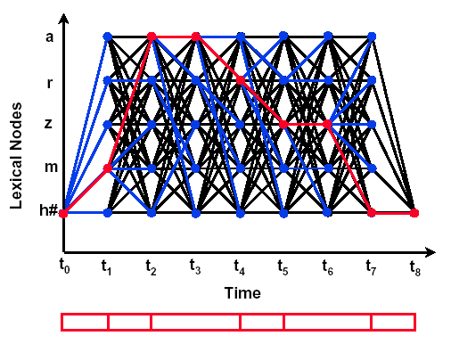
Probabilistic Segmentation
Uses forward Viterbi search in first-pass to find best path
Relative and absolute thresholds are used to speed-up search.

Slide 32
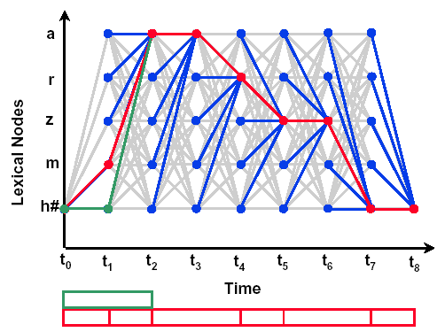
Probabilistic Segmentation (con’t)
Second pass uses backwards A* search to find N-best paths
Viterbi backtrace is used as future estimate for path scores
Block processing enables pipelined computation

Slide 33
Phonetic Recognition Experiments
TIMIT acoustic-phonetic corpus
  462 speaker training corpus, 24 speaker core test set
  Standard evaluation methodology, 39 common phonetic classes
Segment and landmark representations based on averages and derivatives of 14 MFCCs, energy and duration
PCA used for data normalization and reduction
Acoustic models based on aggregated Gaussian mixtures
Language model based on phone bigram
Probabilistic segmentation computed from diphone models

Slide 34
Phonetic Recognition Experiments
Method | % Error
Triphone CDHMM | 27.1
Recurrent Neural Network | 26.1
Bayesian Triphone HMM | 25.6
Anti-phone, Heterogeneous classifiers | 24.4

Slide 35
Phonological Modeling
Phonological Modelling
Words described by phonemic baseforms
Phonological rules expand baseforms into graph, e.g.,
  Deletion of stop bursts in syllable coda (e.g., laptop)
  Deletion of /t/ in various environments (e.g., intersection, destination, crafts)
  Gemination of fricatives and nasals (e.g., this side, in nome)
  Place assimilation (e.g., did you (/d ih jh uw/))
Arc probabilities, P(U|W), can be trained
Most HMMs do not have a phonological component

Slide 36
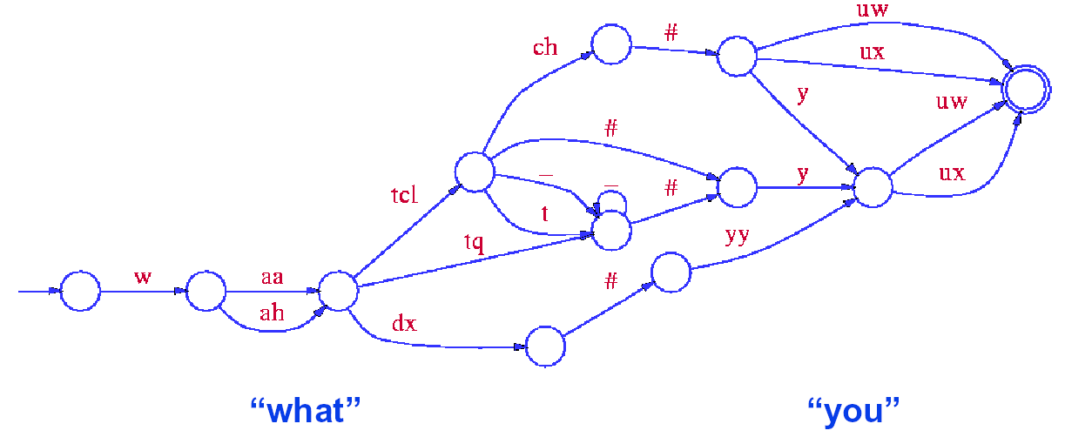
Phonological Example
Example of “what you” expanded in SUMMIT recognizer
  Final /t/ in “what” can be realized as released, unreleased, palatalized, or glottal stop, or flap

Slide 37
Word Recognition Experiments
Jupiter telephone-based, weather-queries corpus
  50,000 utterance training set, 1806 “in-domain” utterance test set
Acoustic models based on Gaussian mixtures
  Segment and landmark representations based on averages and derivatives of 14 MFCCs, energy and duration
  PCA used for data normalization and reduction
  715 context-dependent boundary classes
  935 triphone, 1160 diphone context-dependent segment classes
Pronunciation graph incorporates pronunciation probabilities
Language model based on class bigram and trigram
Best performance achieved by combining models

Slide 38
Word Recognition Experiments
Method | % Error
Boundary models | 7.6
Segment models | 9.6
Combined | 6.1

Slide 39
Summary
Some segment-based speech recognition techniques transform the observation space from frames to graphs
Graph-based observation spaces allow for a wide-variety of alternative modeling methods to frame-based approaches
Anti-phone and near-miss modeling frameworks provide a mechanism for searching graph-based observation spaces
Good results have been achieved for phonetic recognition
Much work remains to be done!

Slide 40
References
J. Glass, “A Probabilistic Framework for Segment-Based Speech Recognition,” to appear in Computer, Speech & Language, 2003.
D. Halberstadt, “Heterogeneous Acoustic Measurements and Multiple Classifiers for Speech Recognition,” Ph.D. Thesis, MIT, 1998.
M. Ostendorf, et al., “From HMMs to Segment Models: A Unified View of Stochastic Modeling for Speech Recognition,” Trans. Speech & Audio Proc., 4(5), 1996.

